Slide 1
Python file
Unit 3

Slide 2

introduction
Files are named locations on disk to store related information. They are used to permanently store data in a non-volatile memory (e.g. hard disk).
Since Random Access Memory (RAM) is volatile (which loses its data when the computer is turned off), we use files for future use of the data by permanently storing them.
When we want to read from or write to a file, we need to open it first. When we are done, it needs to be closed so that the resources that are tied with the file are freed.
Hence, in Python, a file operation takes place in the following order:
Open a file
Read or write (perform operation)
Close the file

Slide 3



Opening a file
Python has a built-in open() function to open a file.
This function returns a file object, also called a handle, as it is used to read or modify the file accordingly.
The syntax : open(filename, mode).
We can specify the mode while opening a file. In mode, we specify whether we want to read r, write w or append a to the file. the mode argument is not mandatory. If not passed, then Python will assume it to be “ r ” by default.
We can also specify if we want to open the file in text mode or binary mode.
The default is reading in text mode. In this mode, we get strings when reading from the file.
On the other hand, binary mode returns bytes and this is the mode to be used when dealing with non-text files like images or executable files.

Slide 4
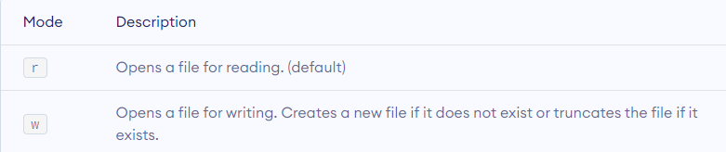


example
file = open("test.txt") # open file in current directory
file = open("C:/Python38/README.txt") # specifying full path

Slide 5
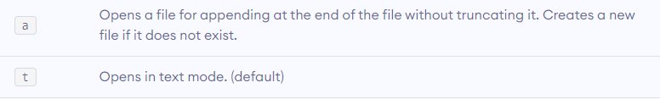
f = open("test.txt") # equivalent to 'r'
f = open("test.txt",'w') # write in text mode

Slide 6
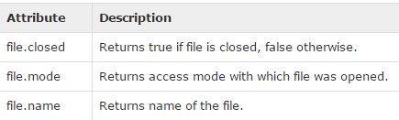
The File Object Attributes
Once a file is opened and you have one file object, you can get various information related to that file.
Here is a list of all attributes related to file object:

Slide 7
example
file = open("foo.txt", "w")
print ("Name of the file: ", file.name )
print ("Closed or not : ", file.closed )
print ("Opening mode : ", file.mode)

Slide 8
Closing a file
Once all the operations are done on the file, we must close it through our Python script using the close() method. Any unwritten information gets destroyed once the close() method is called on a file object.
Syntax:- fileobject.close()
# Open a file
fo = open("foo.txt", "w")
print ("Name of the file: ", fo.name)
# Close opened file
fo.close()

Slide 9
The write() Method
The write() method writes any string to an open file. It is important to note that Python strings can have binary data and not just text.
The write() method does not add a newline character ('\n') to the end of the string −
Syntax
fileObject.write(string)

Slide 10






example
fo = open(“demo.txt", "w")
fo.write( "Python is a great language.\nYeah its great!!\n")
# Close opened file
fo.close()

Slide 11

The read() Method
The read() method reads a string from an open file. It is important to note that Python strings can have binary data apart from text data.
Syntax
fileObject.read([count]);

Slide 12
example
# Open a file
fo = open("foo.txt", "r")
str = fo.read(10);
print ("Read String is : ", str)
# Close opend file
fo.close()

Slide 13
readlines() Method
The readlines() method returns a list containing each line in the file as a list item.
Return all lines in the file, as a list where each line is an item in the list object
Syntax:-
file.readlines()
Example:-
f = open("demofile.txt", "r") print(f.readlines())

Slide 14
How to read specific lines from a File in Python?
Method- fileobject.readlines()
A file object can be created in Python and then readlines() method can be invoked on this object to read lines into a stream.
This method is preferred when a single line or a range of lines from a file needs to be accessed simultaneously.
It can be easily used to print lines from any random starting index to some ending index.
It initially reads the entire content of the file and keep a copy of it in memory. The lines at the specified indices are then accessed.

Slide 15
example
# open the sample file used
file = open('demofile.txt')
# read the content of the file opened
content = file.readlines()
# read 5th line from the file
print("5th line")
print(content[4])
# print first 3 lines of file
print("first three lines")
print(content[0:3])

Slide 16
Python seek() function
In Python, seek() function is used to change the position of the File Handle to a given specific position. File handle is like a cursor, which defines from where the data has to be read or written in the file.
Syntax: f.seek(offset, from_what), where f is file pointer
Parameters: Offset: Number of postions to move forward from_what: It defines point of reference.

Slide 17
The reference point is selected by the from_what argument. It accepts three values:
0: sets the reference point at the beginning of the file
1: sets the reference point at the current file position
2: sets the reference point at the end of the file
By default from_what argument is set to 0.

Slide 18
Python tell() function
Similarly, the tell() method returns our current position (in number of bytes).
File handle is like a cursor, which defines from where the data has to be read or written in the file. Sometimes it becomes important for us to know the position of the File Hanlde.
tell() method can be used to get the position of File Handle. tell() method returns current position of file object.
This method takes no parameters and returns an integer value. Initially file pointer points to the beginning of the file(if not opened in append mode). So, the initial value of tell() is zero.
Syntax:-
file_object.tell()

Slide 19
example
# Opening “demo.txt" text file
f = open(“demo.txt", "r")
# Second parameter is by default 0 sets Reference point to twentieth .index position from the beginning
f.seek(20)
# prints current postion
print(f.tell())
print(f.readline())
f.close()

Slide 20
Truncate() function
When the entire data has to be deleted but not the file it is in :-
Truncate() method truncate the file’s size. If the optional size argument is present, the file is truncated to (at most) that size. The size defaults to the current position.
To truncate the file, you can open the file in append mode or write mode.
f=open("demofile.txt","w")
f.truncate()
f.close()

Slide 21
The rename() Method
The rename() method takes two arguments, the current filename and the new filename.
Syntax
os.rename(current_file_name, new_file_name)
Example
import os
# Rename a file from foo.txt to test2.txt
os.rename( “foo.txt", "test2.txt" )

Slide 22
The remove() Method
You can use the remove() method to delete files by supplying the name of the file to be deleted as the argument.
Syntax
os.remove(file_name)
Example
import os
# Delete file test2.txt
os.remove("test2.txt")

Slide 23
Practical 3
Create a text file “story.txt” and put a story of your choice.
Write code for following:-
Display the name of the file and mode in which it is opened.
Append a Moral at the end of file.
Display the story line by line.
Retrieve the position of the line where moral starts.
Rename the file to the name of the story which you have written.
Delete the contents of the file.
Delete the file.

Slide 24
practice
Python Program to Read a String from the User and Append it into a File

Slide 25
Manipulating directories
The mkdir() Method
You can use the mkdir() method of the os module to create directories in the current directory.
Syntax:- os.mkdir("newdir")
Example
import os
# Create a directory "test"
os.mkdir("test")
This method takes in the path of the new directory. If the full path is not specified, the new directory is created in the current working directory.
If a directory already exists, os.mkdir() raises FileExistsError.

Slide 26
Getting Current Working Directory (CWD)
os.getcwd() can be used.
It returns a string that represents the path of the current working directory.
Example:
import os
print("String format :", os.getcwd())

Slide 27
Renaming a directory
os.renames() method is used to rename the directory.
The parameters passed are old_name followed by new_name.
If a directory already exists with the new_name passed, OSError will be raised.
os.renames(‘old_name’,’dest_dir:/new_name’) method works similar to os.renames() but it moves the renamed file to the specified destination directory(dest_dir).
Example:
import os
os.renames('file1', 'D:/file1_renamed')

Slide 28
Changing Current Working Directory (CWD)
Every process in the computer system will have a directory associated with it, which is known as Current Working Directory(CWD).
os.chdir() method is used to change it.
The parameter passed is the path/name of the desired directory to which one wish to shift.
Example
import os
# Changing a directory to "/home/newdir"
os.chdir("/home/newdir")

Slide 29
Removing a directory
The rmdir() method deletes the directory, which is passed as an argument in the method.
Before removing a directory, all the contents in it should be removed.
It is required to give fully qualified name of the directory, otherwise it would search for that directory in the current directory.
Syntax:
os.rmdir('dirname')
Example
import os
os.rmdir( "C:/Python34/test/test" )
OR
Import shutil
shutil.rmtree("C:/Users/Prathmesh/Desktop/VISHAKHA/VB PD/PP/test") – To delete folder containing different files.

Slide 30
Iterables
List, strings, tuples, files etc
Iterable is capable of creating iterators.
To be an iterable you need to be able to create your own iterator
Iterator is an object created from calling the __iter__() method.
Iterator has the ability to go through each element in an iterable one by one.
They utilize the __next__() method.
Eg:
list=[1,2,3,4]
for i in list:
print i

Slide 31
For is calling the __iter__() function on list and creating a iterator and next it will call the next() method until the list is exhausted

Slide 32
iterators
Iterators are objects that can be iterated upon. Iterators are everywhere in Python. They are elegantly implemented within for loops, comprehensions, generators etc. but hidden in plain sight.
Iterator in Python is simply an object that can be iterated upon. An object which will return data, one element at a time.
Technically speaking, Python iterator object must implement two special methods, __iter__() and __next__(), collectively called the iterator protocol.
An object is called iterable if we can get an iterator from it. Most of built-in containers in Python like: list, tuple, string etc. are iterables.
The iter() function (which in turn calls the __iter__() method) returns an iterator from them.

Slide 33
Iterating through an iterator
WE USE THE NEXT() FUNCTION TO MANUALLY ITERATE THROUGH ALL THE ITEMS OF AN ITERATOR. WHEN WE REACH THE END AND THERE IS NO MORE DATA TO BE RETURNED, IT WILL RAISE STOPITERATION.
https://www.programiz.com/python-programming/iterator

Slide 34
# define a list
my_list = [4, 7, 0, 3]
# get an iterator using iter()
my_iter = iter(my_list)
# iterate through it using next()
# Output: 4
print(next(my_iter))
# Output: 7
print(next(my_iter))
# next(obj) is same as obj.__next__()
# Output: 0
print(my_iter.__next__())
# Output: 3
print(my_iter.__next__())
# This will raise error, no items left
next(my_iter)

Slide 35
Python Anonymous/ Lambda function
In Python, an anonymous function is a function that is defined without a name.
While normal functions are defined using the def keyword in Python, anonymous functions are defined using the lambda keyword.
Hence, anonymous functions are also called lambda functions.
Syntax of Lambda Function
lambda arguments: expression
Lambda functions can have any number of arguments but only one expression. The expression is evaluated and returned. Lambda functions can be used wherever function objects are required.

Slide 36
example
Here is an example of lambda function that doubles the input value.
# Program to show the use of lambda functions
double = lambda x: x * 2
print(double(5))
This function has no name. It returns a function object which is assigned to the identifier double
Lambda function
x is argument
x*2 is expression

Slide 37
Python Modules
Modules refer to a file containing Python statements and definitions.
A file containing Python code, for example: eg.py is called a module, and its module name would be eg.
We use modules to break down large programs into small manageable and organized files. Furthermore, modules provide reusability of code.
We can define our most used functions in a module and import it, instead of copying their definitions into different programs.
Let us create a module. Type the following and save it as eg.py

Slide 38
# Python Module example
def add(a, b):
"""This program adds two
numbers and return the result"""
result = a + b
return result

Slide 39
Here, we have defined a function add() inside a module named eg. The function takes in two numbers and returns their sum.
How to import modules in Python?
We can import the definitions inside a module to another module or the interactive interpreter in Python.
We use the import keyword to do this. To import our previously defined module eg , we type the following in the Python prompt.
import eg
Using the module name we can access the function using the dot . operator. For example:
eg.add(2,3)

Slide 40
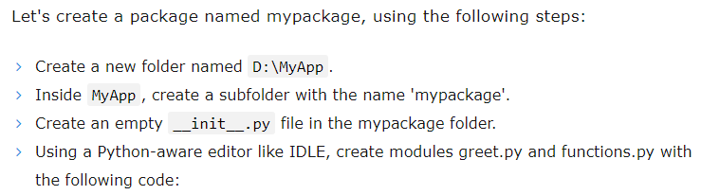
Python packages

Slide 41
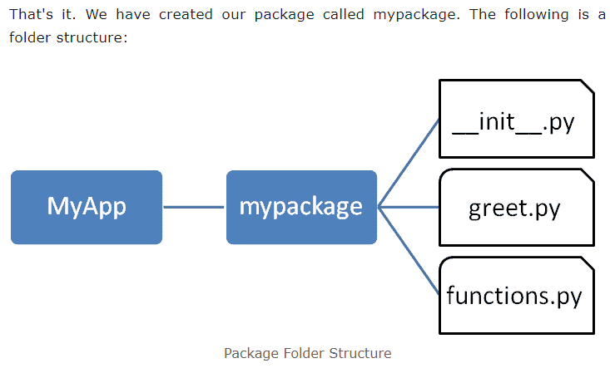

Slide 42
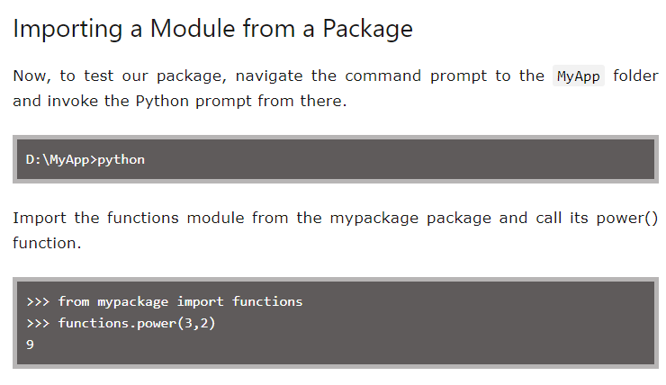
https://www.tutorialsteacher.com/python/python-package

